Slide 1

Influencer Campaign Revenue Prediction
(Regression Model)
By:
Fatima Alkhatib
Zaina Mohamadieh
Osama Habash
Rahaf Hani

Slide 2



Business Problem
Followers ≠ Sales:
Fixing Wasted Marketing Spend
The Flawed Approach: Relying on vanity metrics (engagement & followers) to evaluate influencers.
The Missing Link: Inability to connect influencer campaigns to tangible product sales.
The Business Cost: Wasted marketing budgets and poor Return on Investment (ROI).

Slide 3

Project Objectives
Smart Spend
Predict Sales: Develop a regression model to forecast dollar value sales per influencer campaign.
Optimize Budgets: Enable data-driven decisions targeting highest financial ROI, not just engagement.

Slide 4
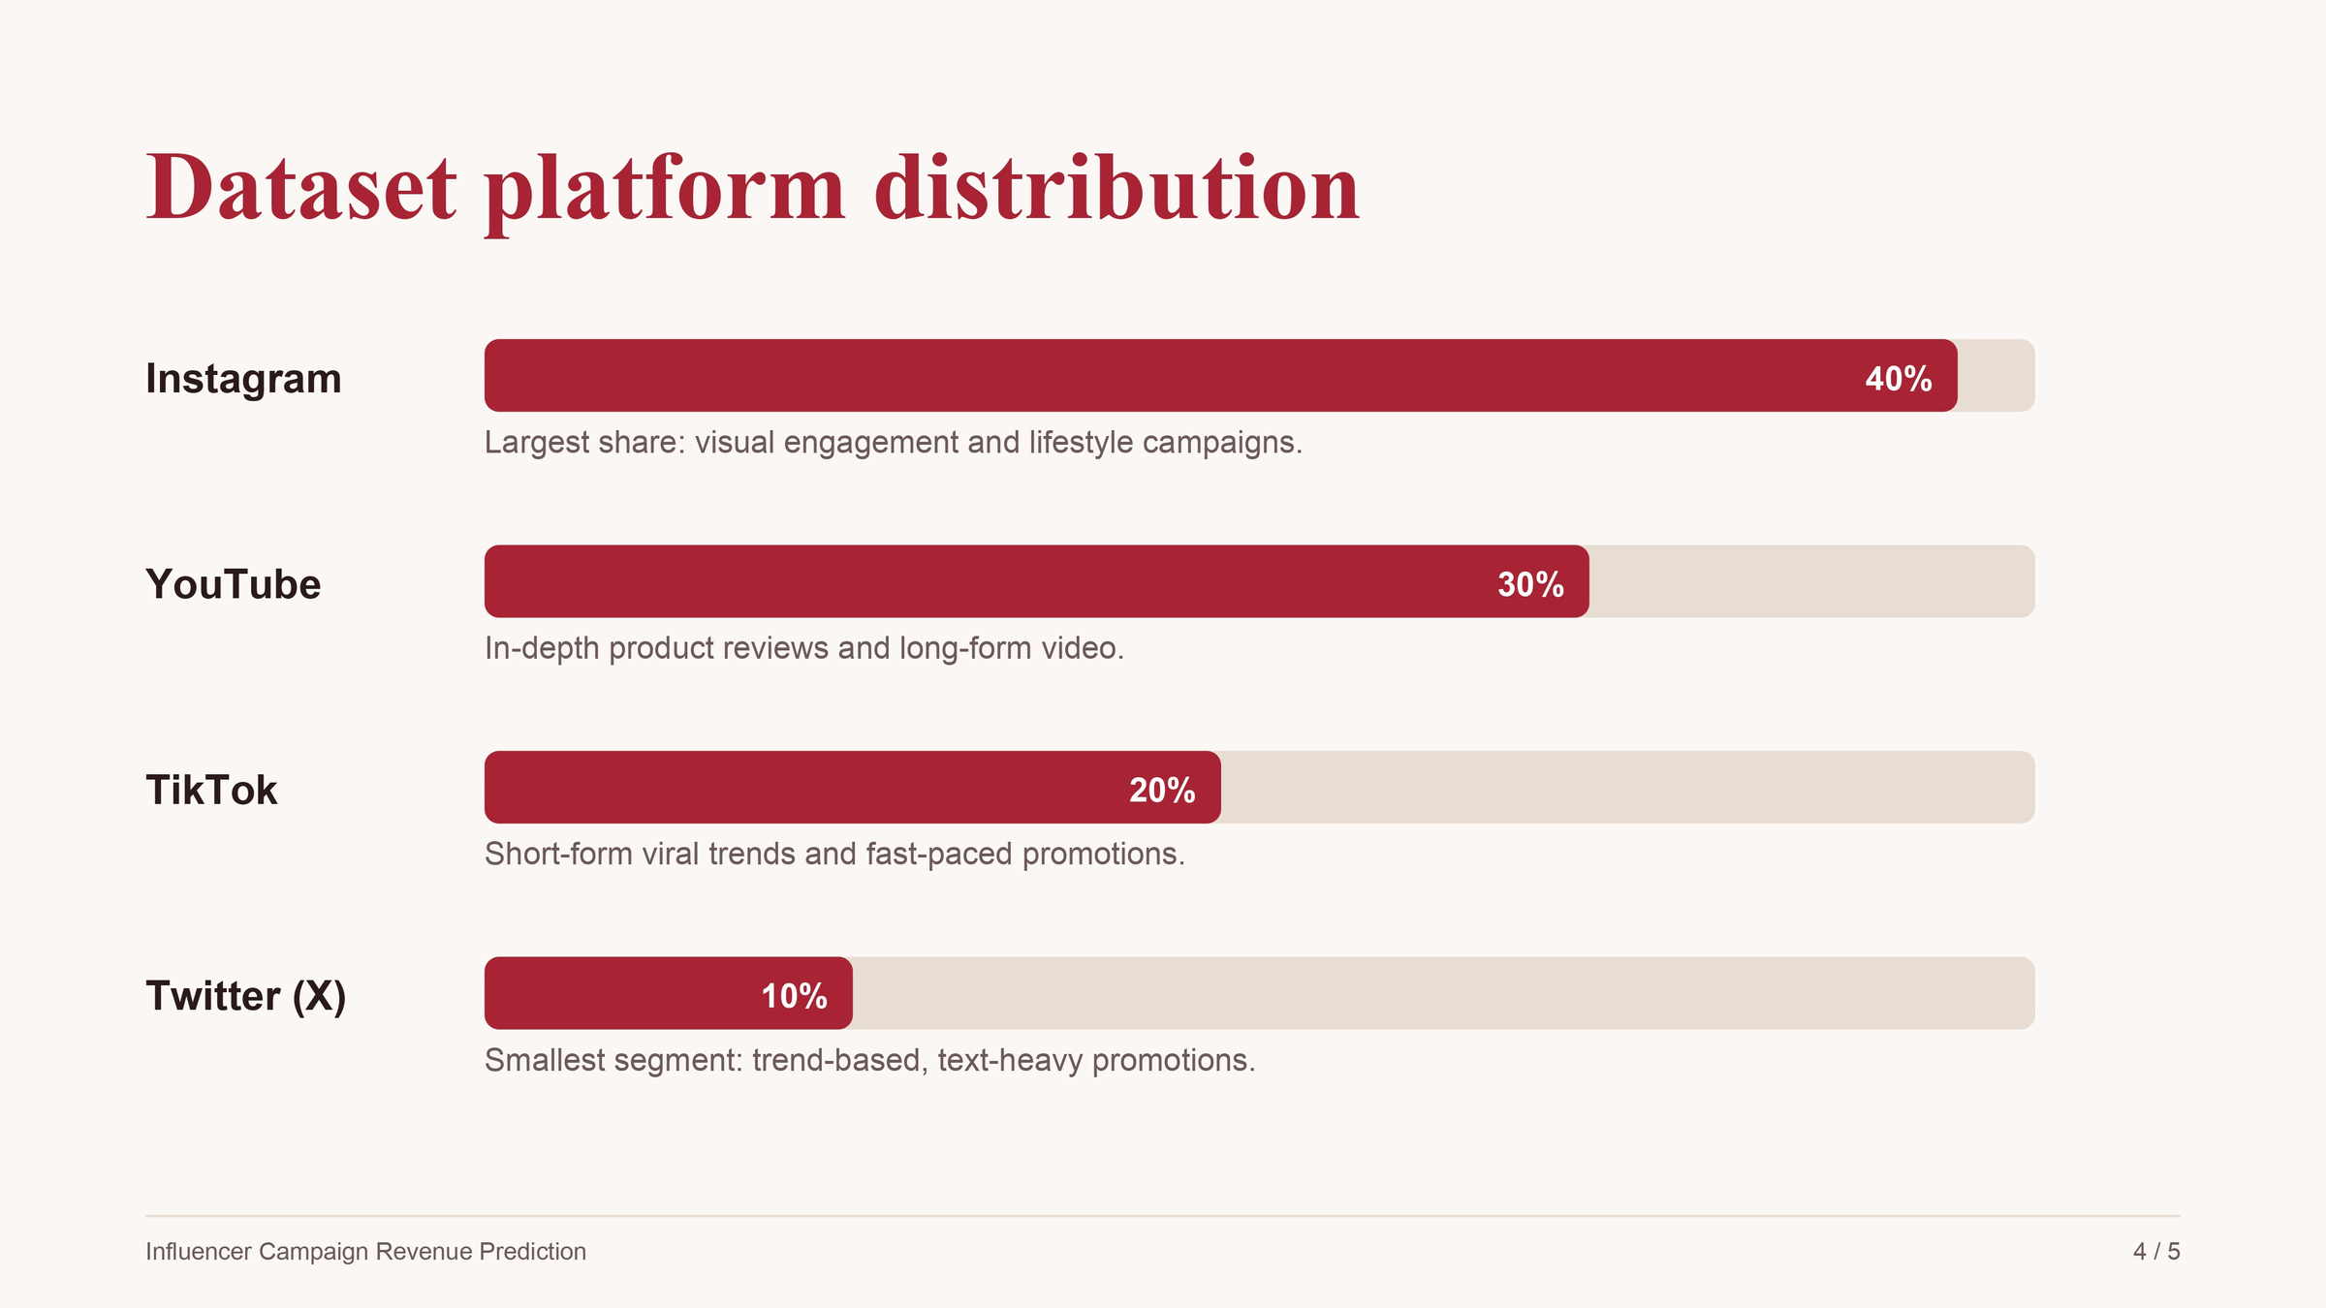

Slide 5
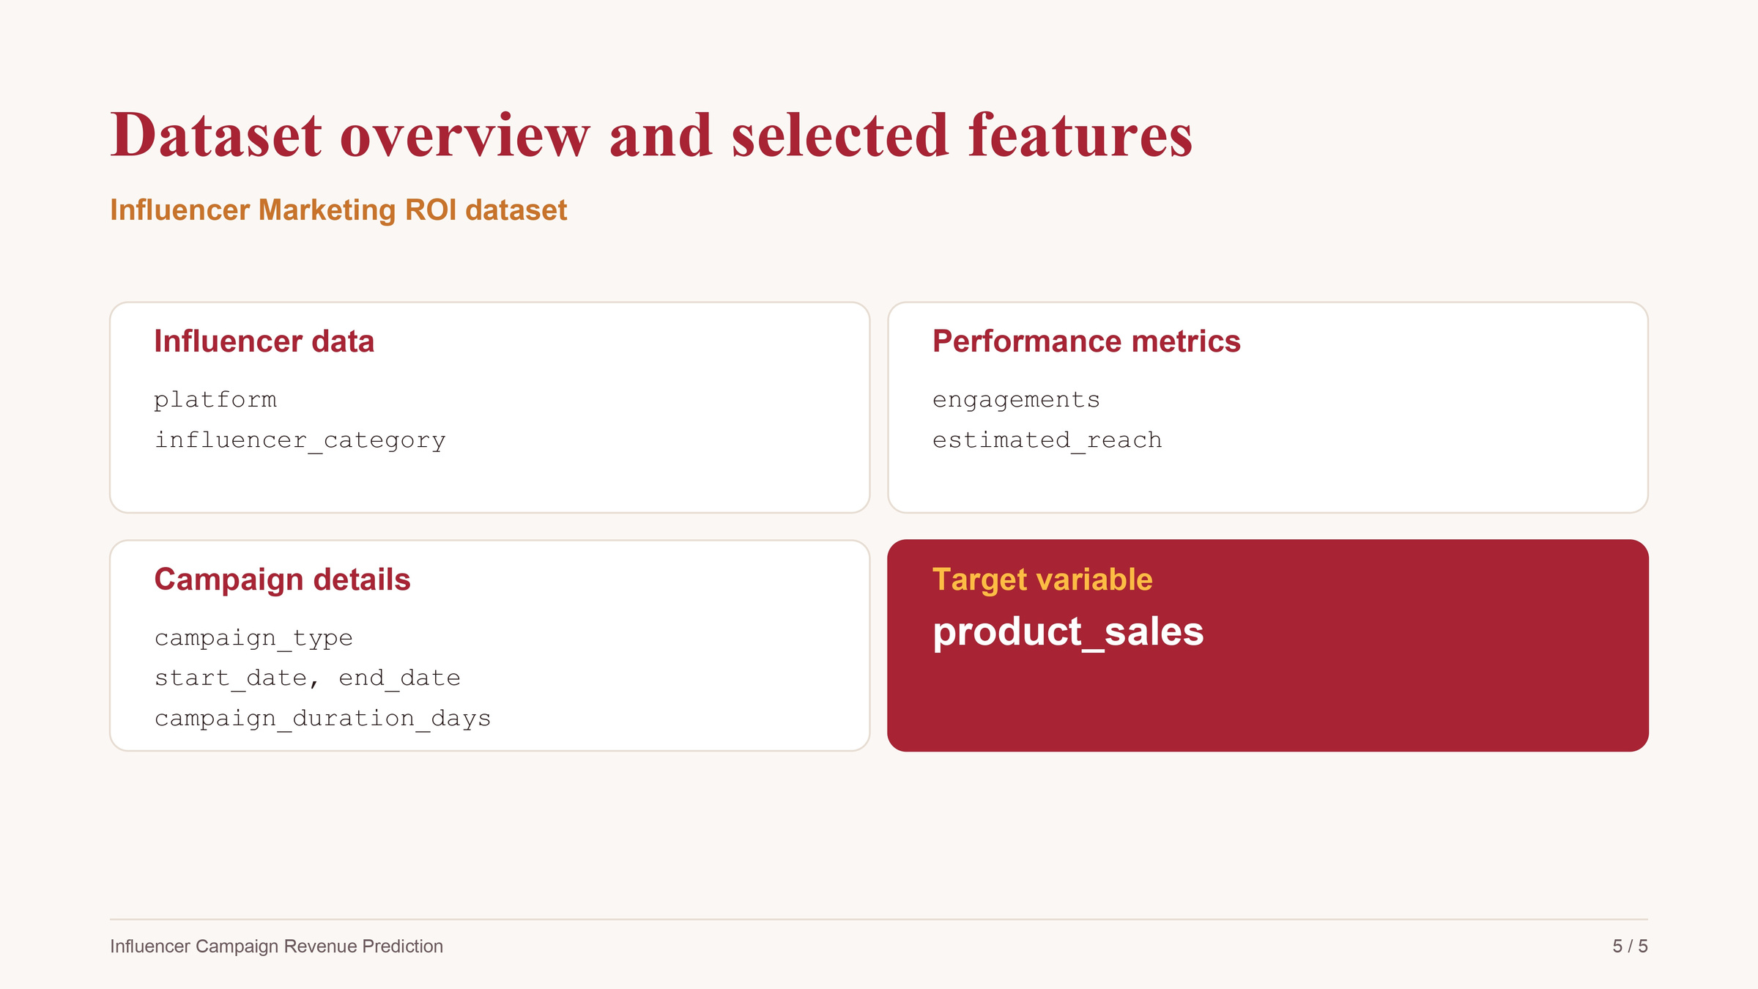

Slide 6

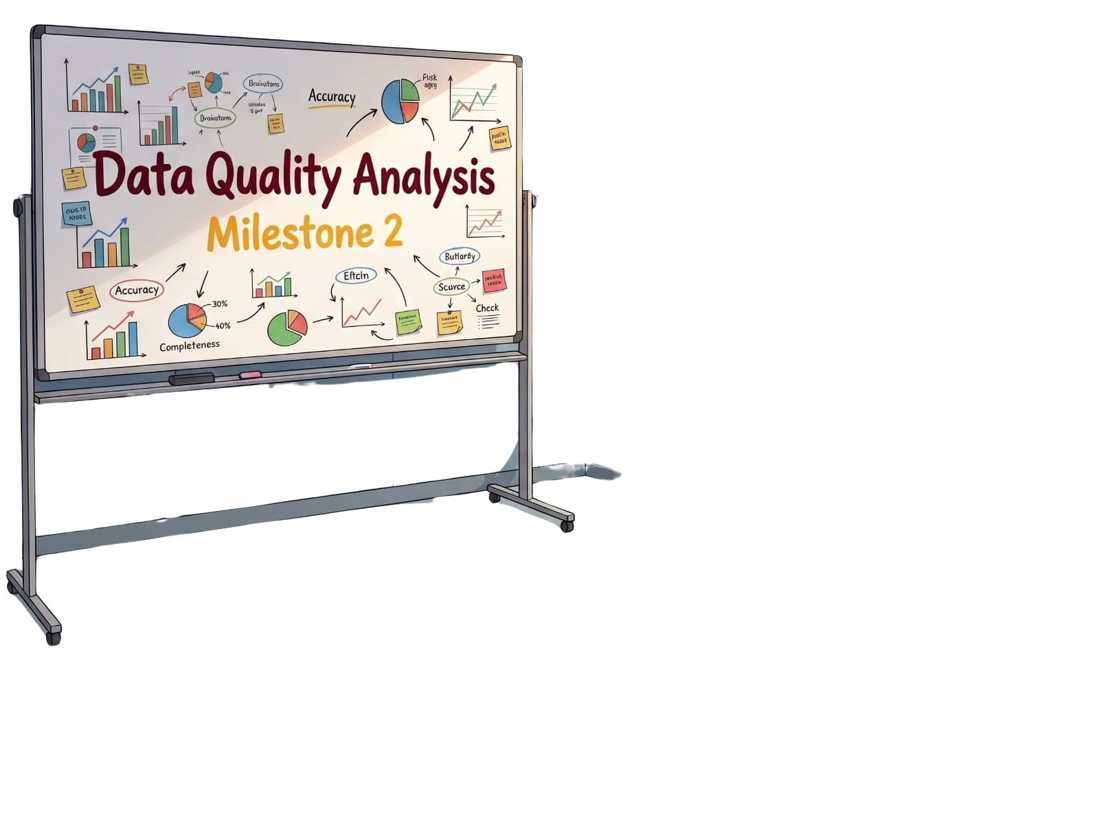


Slide 7

Milestone 2: Data Understanding & Cleaning
Cleaning Influencer Marketing Data Before Modeling
  Prepared 150,000 campaigns for accurate modeling.
  Handled missing values, duplicates, and data anomalies.

Slide 8

Load & Inspect the Data
Establishing the data baseline
  Dataset Size: Imported a raw dataset consisting of 150,000 campaigns and 10 features.
  Initial Audit: Detected duplicated rows and missing data points across key columns.
  Data Structure: Reviewed data types to ensure dates and numerical fields are ready for processing.

Slide 9
Simulating Real-World Anomalies
Testing robustness by introducing intentional errors
Outliers:
Injected extreme values into
to mimic tracking errors.
Logical Errors:
Created negative
values.
Missing Data: Randomly inserted null values across
and
campaign_
duration_days
'product_sales'
'estimated_reach'
'engagements'.

Slide 10

Data Quality Analysis
Identifying the scope of data corruption
  Missing Values: Quantified the exact percentage of nulls in and
'engagements'
'reach'.
  Duplicates: Identified 1,000 duplicated campaign IDs requiring removal.
  Anomalies: Detected the negative durations and extreme upper-bound outliers in sales using IQR calculation.

Slide 11






Cleaning Decisions & Execution
Fixing data issues to ensure model integrity
Deduplication
Dropped exact duplicated rows based on unique 'campaign_id'.
Standardization
Cleaned text fields and filled missing platforms with 'Unknown'.
Imputation & Correction
Recomputed negative durations and imputed missing numerical values.
Outlier Removal
Filtered out the extreme artificial outliers in 'product_sales'.

Slide 12
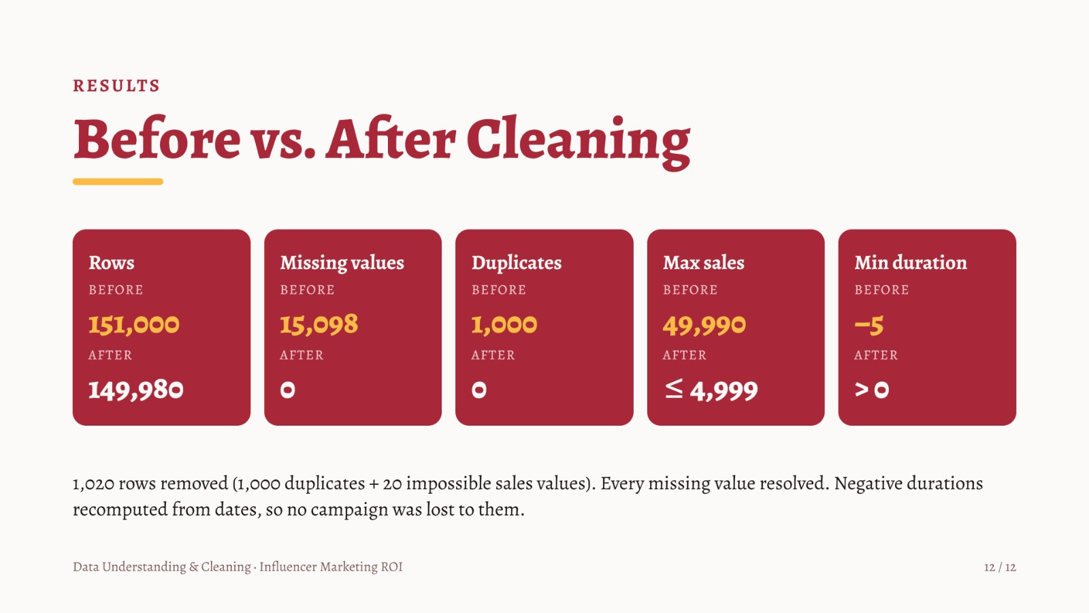

Slide 13


Slide 14







MILESTONE 3 · MODEL PREPARATION
1
Load Dataset
Preparing the Data for the Regression Model
2
EDA & Correlation
3
Feature Engineering
4
Encoding
"Transforming raw data into predictive features to uncover true campaign ROI."
5
Train / Test Split
6
Scaling
Dataset: influencer_marketing_roi_dataset.csv · Target: product_sales

Slide 15



STEP 1: Data Initialization
Load the Cleaned Dataset
Start from clean data
Milestone 2 · Cleaned Data
We load the output of Milestone 2, so every later step builds on one trusted, already-cleaned source.
influencer_marketing_roi_dataset.csv
Ready for Modeling
Successfully imported the dataset to begin feature engineering and predictive modeling
Model-Ready Dataset

Slide 16



The Hidden Challenge
Aligning Data with Business Logic
Why we had to rebuild the 'product_sales' variable?
The Problem
The Business Solution
The Result
The original sales figures were disconnected from campaign performance. There was no logical relationship between metrics (like engagement) and the actual sales, making predictive modeling impossible
We acted as business architects. We reconstructed the sales column using explicit, real-world marketing rules (e.g., higher engagement and video platforms like YouTube drive more sales)
We added natural market variance (noise). Now, we have a dataset that truly reflects influencer marketing dynamics, ready for our Heatmap and Machine Learning models

Slide 17



STEP 2: Exploratory Data Analysis
Exploratory Data Analysis
Correlation matrix
engagements
product_sales
Analyzed relationships to uncover which metrics truly drive product sales.
positive correlation (r ≈ 0.5)
Heatmap view
Visualized the strongest drivers: Marketing efforts vs. Final Revenue.
COLOR SCALE
Key insight
-1 negative
0
+1 positive
Engagements and campaign days (r ≈ 0.5) drive sales; Product Launch is the top type.
Relationships we analyze in this project

Slide 18



STEP 2: Relationships in the Data
Relationships in the Data
Numeric drivers
Revenue Impact Summary
Engagements and campaign days correlate about 0.5 with sales; reach about 0.32.
Up: engagements, days, Launch
Categories
Product Launch (+0.40), YouTube (+0.26) and Tech (+0.18) raise sales; TikTok (−0.25) and Twitter (−0.17) lower it.
Down: TikTok, Twitter

Slide 19



STEP 3: Feature Engineering
Feature Engineering
Created 'Engagement Rate
NEW FEATURE
Engagements divided by reach standardizes engagement regardless of reach size, so small and large campaigns become comparable.
engagements
estimated_reach
engagement_rate
÷
=
DROPPED → KEPT
Removed Redundancy
start_date
start_date and end_date are redundant: campaign_duration_days already captures the campaign length.
campaign_duration_days
end_date
Timing already covered

Slide 20



STEP 4: Encoding Categorical Variables
Encoding Categorical Variables
One-Hot Encoding
BEFORE
AFTER
Models only understand numbers, so each text category becomes its own 0/1 column.
platform
TikTok
Twitter
YouTube
Instagram
0
0
0
Three text columns
Converted text data (platform, category, and campaign type) into machine-readable numeric formats
TikTok
1
0
0
Twitter (X)
0
1
0
Baseline Referenc
YouTube
0
0
1
Removed one baseline column per feature to avoid perfectly correlated columns.
Illustration: Instagram is the dropped baseline (all zeros)

Slide 21




STEP 5: Train / Test Split
Train / Test Split
Defining Inputs & Target
df_encoded
Separated predictive features from our target (Sales), holding out 20% of data for final testing.
TRAIN
80%
TEST
20%
Removing Identifiers
Dropped 'campaign_id' as it offers no predictive value for revenue.
X · features
y · product_sales
Split BEFORE scaling
random_state=42 · reproducible split
Critical rule: it prevents test-set information from leaking into training.

Slide 22




STEP 6: Scaling & Normalization
Scaling & Normalization
Standardizing Features
Ensured all numerical inputs are on the same scale, preventing large values from artificially dominating the model
Strict Zero-Leakage Policy
The scaler was strictly fitted on the 80% training data to maintain the integrity of our test set
Model-ready data
Fully numeric, split without overlap, and no data leakage.

Slide 23


RESULT · MILESTONE 3
Ready for Regression Modeling
Load
EDA
Features
Encode
Split
Scale
100%
80 / 20
0
numeric features
train / test split
data leakage
One-Hot Encoding turned every text column into numbers.
Maintained a reproducible and balanced train/test split for reliable model evaluation
Split first, then the scaler is fit on the training set only.

Slide 24


Slide 25


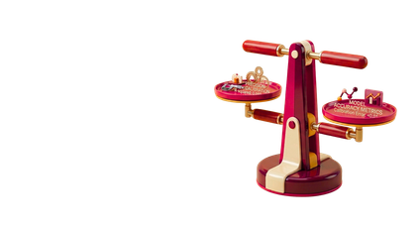

MILESTONE 4 · MACHINE LEARNING
1
Select Models
Training & Comparing the Regression Models
2
Cross-Validate
3
Compare Models
Building a robust predictive engine to forecast actual campaign revenue
4
Challenges & Next Steps
Target: Campaign Revenue | Evaluation Metrics: R², RMSE, MAE

Slide 26


STEP 1: Model Selection Strategy
Models Selected & Why
Baseline first
Baseline: mean (RMSE 1698)
Predicting the mean sale (RMSE 1,698) is the yardstick. Linear Regression and Lasso add simple benchmarks.
Linear: Linear, Lasso
Non-linear models
Random Forest and Hist Gradient Boosting can capture interactions between platform, category and engagement.
Trees: RF, Hist Boosting

Slide 27
STEP 2: Model Validation Strategy
Ensuring a Fair & Robust Comparison
Rigorous Testing (5-Folds)
Evaluation Focus: Minimizing Error (RMSE)
Each model is trained and validated on 5 different folds, so its score does not depend on one lucky split.
Training Data (80%)
5-Fold Cross-Validation
Same rules for all
All models faced the exact same conditions, data splits, and evaluation metrics (R², RMSE, MAE)
Strict Isolation to Prevent Leakage
Unbiased Final Check
Holdout Test Data (20%)
Final Reality Check
Selected the best model based on validation, leaving the test set completely unseen for a realistic final score

Slide 28

STEP 3 OF 4 · FINAL MODEL
The Winning Model: Lasso Regression
Clean
Encode
Split
Models
Validate
Select
0.944
400.8
0.942
Test R²
Test RMSE
CV R² (5-fold)
Explains 94% of sales variance.
Beats the 1698 baseline
Proves model stability

Slide 29
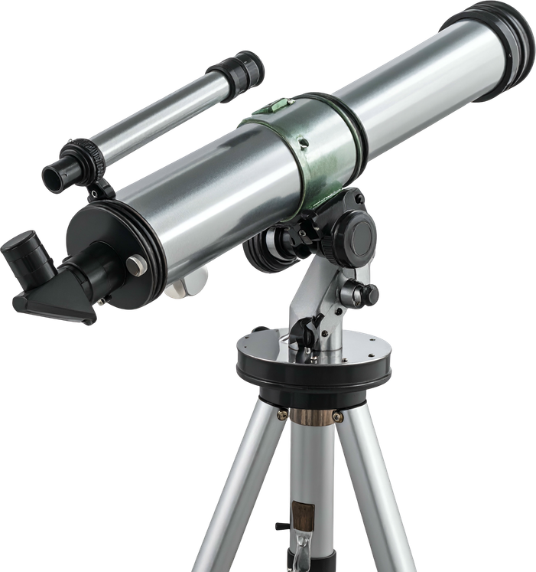


STEP 4: Future Roadmap
Challenges & Improvements
Challenges faced
Roadmap
Overcame severe data quality issues and implemented strict testing protocols to ensure highly reliable predictions
COLLECT
real drivers
TEST
real data
Limitation
Current Proof-of-Concept: The model successfully learned the simulated market rules, proving our architecture works flawlessly.
Ad budget
Follower count
Next improvements
Re-test on real campaign sales
Incorporate live market metrics: ad spend, follower growth, and conversion rates

Slide 30





